Slide 1

BASIC ELECTRONICS AND ELECTRICAL ENGINEERING
BY- CHANDANA MN (CSE-087)
HARSHITHA MASUR(AE-016)
PRIYANKA HANSDA(AE-009)
ASSIGNED BY- DR.HARINATH AIREDDY

Slide 2
HALF WAVE RECTIFIER WITH & WITH OUT FILTER

Slide 3
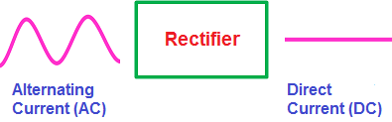
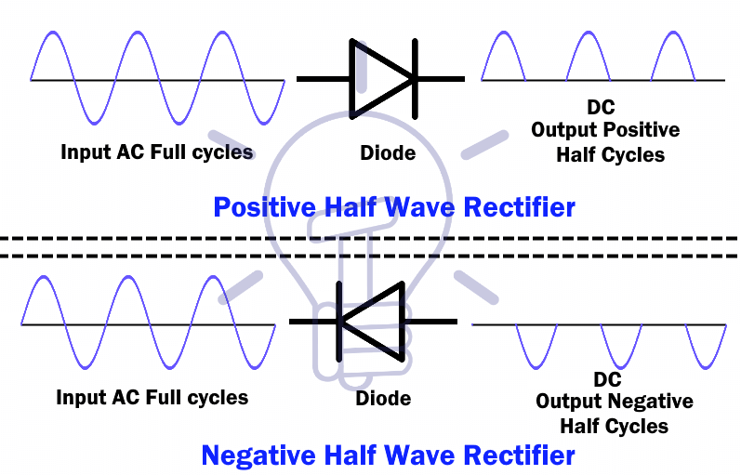
rectifier
A rectifier is a device that converts an oscillating two-directional alternating current (AC) into a single-directional direct current (DC).

Slide 4
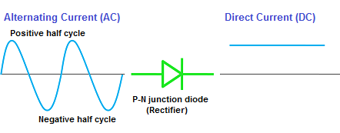
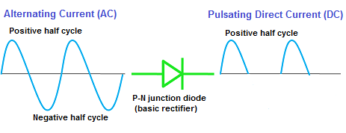
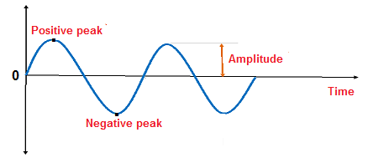
The AC voltage or AC current is often represented by a sinusoidal waveform whereas the DC current is represented by a straight horizontal line.
In the sinusoidal waveform, the upper half cycle represents the positive half cycle, and the lower half cycle represents the negative half cycle.
The positive half cycle of the AC voltage is analogous to the forward bias DC voltage and the negative half cycle of the AC voltage is analogous to the reverse bias DC voltage.

Slide 5
Types of rectifiers
The rectifiers are mainly classified into two types:
Half wave rectifier
Full wave rectifier

Slide 6
Half wave rectifier
The half wave rectifier is a type of rectifier which converts half of the AC input signal (positive half cycle) into pulsating DC output signal.
and the remaining half signal (negative half cycle) is blocked or lost.
In half wave rectifier circuit, we use only a single diode.

Slide 7
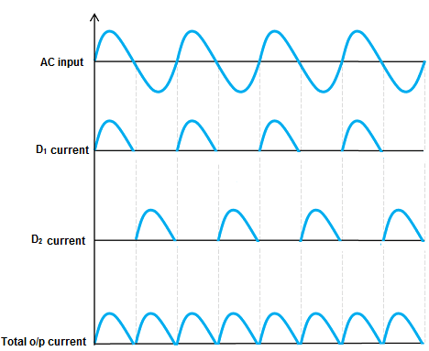
Full wave rectifier
The full wave rectifier is a type of rectifier which converts the full AC input signal (positive half cycle and negative half cycle) to pulsating DC output signal.
Unlike the half wave rectifier, the input signal is not wasted in full wave rectifier.
The efficiency of full wave rectifier is high as compared to the half wave rectifier.

Slide 8

NOW LET US GO TO THE EXPERIMENT

Slide 9
Aim:
To study the operation of Half Wave Rectifier with and without filter and calculate its Ripple Factor and Efficiency.

Slide 10
Apparatus Required:
SL.NO | Component | Range | Required
1 | Diode | 1N4007 | 1
2 | Resistor | 1KΩ | 1
3 | Transformer | 9V-0-9V or 12V-0-12V | 1
4 | Capacitor | 470µF | 1
5 | Voltmeter | (0-20V) | 1
6 | Cathode Ray Oscilloscope(CRO) - | - | 1
7 | Bread board & Wires | - | -

Slide 11
Theory:
Rectifier is a circuit which converts AC input signal to DC output signal. The halfwave rectifier circuit passes one half of each complete sinewave of the AC supply in order to convert it into a DC supply. It is called as halfwave rectifier because it passes only half of the AC power supply.
During positive half cycle of the AC sinewave, the diode is forward biased , resulting in current flowing through the diode. (V_{out} = V_{in})
During negitive half cycle of the AC sinewave, the diode is reverse biased , resulting in no current flowing through the diode. (V_{out} = 0)

Slide 12
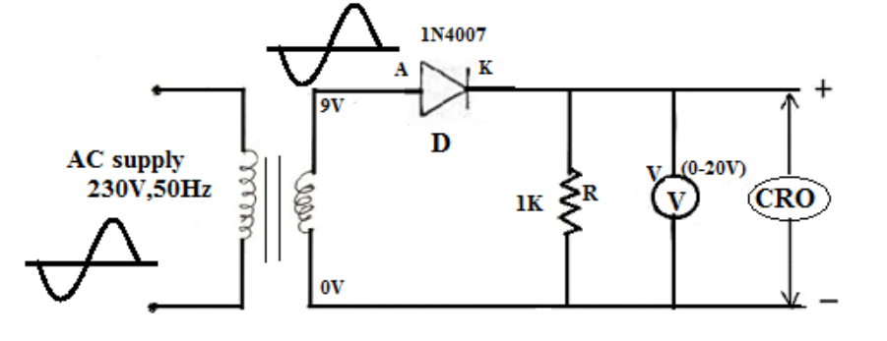
Circuit Diagram:
Half Wave Rectifier (without filter):

Slide 13
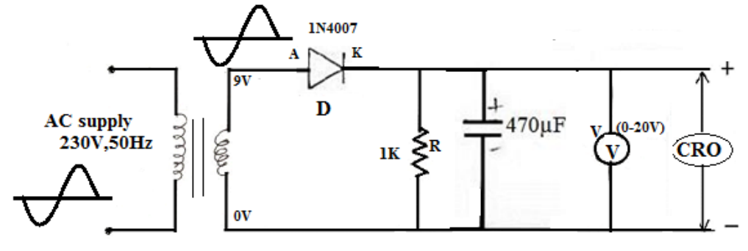
Half Wave Rectifier (with filter):

Slide 14
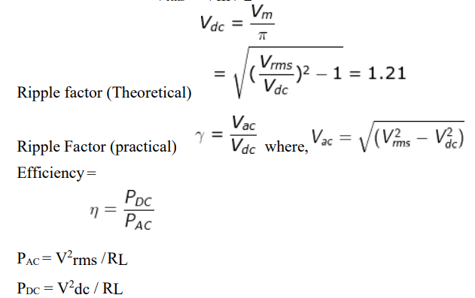
Calculation :
Vrms = Vm / 2
Ripple factor (Theoretical)=
Ripple Factor (practical)=
Efficiency =
P_{AC} = V² _{rms} /R_{L}
P_{DC} = V² _{dc} / R_{L}
Without Filter:

Slide 15
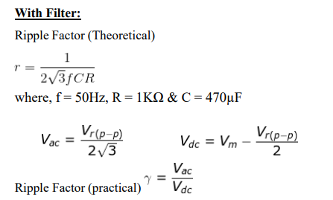
With Filter:
Ripple Factor (Theoretical)=
where, f = 50Hz, R = 1KΩ & C = 470µF
Ripple Factor (practical)=

Slide 16
Procedure:
1. Connect the circuit as shown in the circuit diagram.
2. Connect the primary side of the transformer to AC mains and the secondary side to rectifier input.
3. Connect the CRO probe across the input side that is secondary of transformer and note down the amplitude of the sinewave.

Slide 17
Cont.
4. Without filter :
Connect the CRO probe across the load resistor to measure the voltage Vm at the output of the rectifier.
Using output voltage Vm calculate and verify the ripple factor and efficiency of the halfwave rectifier.

Slide 18
Cont.
5. With Filter:
Connect the CRO probe across the capacitor to measure the voltage Vm and V_{r(p-p)} at the output of the rectifier.
Using output voltage Vm and V_{r(p-p)} calculate and verify the ripple factor of the halfwave rectifier.
6. Verify the waveforms of halfwave rectifier with and without filter.

Slide 19
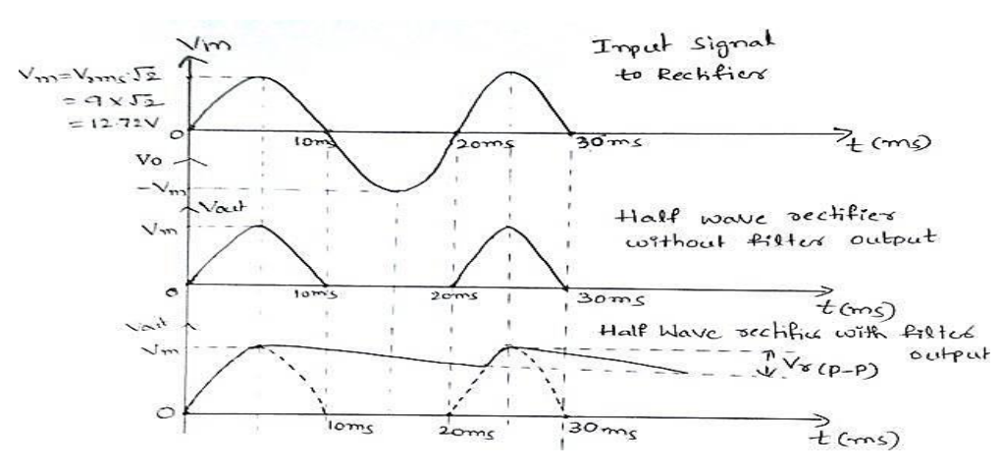
Expected Waveforms:

Slide 20
Result:
The operation of Half Wave rectifier is studied, and the following are calculated.
Type of | Ripple | factor | Efficiency
Rectifier | Theoretical | Practical
HWR without filter
HWR with filter

Slide 21
Applications and Uses of Rectifiers
The primary application of the rectifier is to derive DC power from AC power.
Rectifiers are used inside the power supplies of almost all electronic equipment.
used for powering appliances
used with transformers
Uses of rectifier while soldering
used in AM radio
used for modulation
used in voltage multiplier

Slide 22


